Slide 1
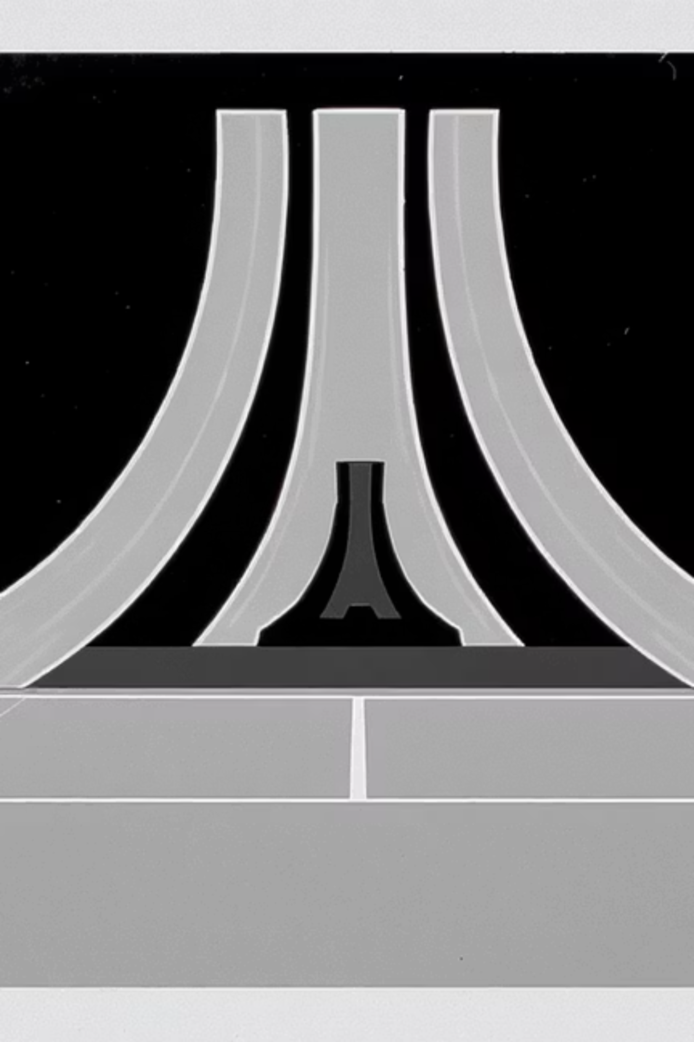
Deep Q-Learning Agent for Atari 'Tennis-v5'

Slide 2

Introduction
Hello everyone! This presentation demonstrates a Deep Q-Learning agent implemented in PyTorch and trained to play the Atari game Tennis-v5 using the Gymnasium framework.

Slide 3
Environment Setup
Gymnasium & AutoROM
Environment Wrappers
Observation & Action Space
Used for Atari environment installation and licensing.
AtariPreprocessing, ResizeObservation, and FrameStack ensure consistent 84x84 grayscale input and temporal context.
Observation shape: (4, 84, 84). Action space: 18 discrete actions.

Slide 4
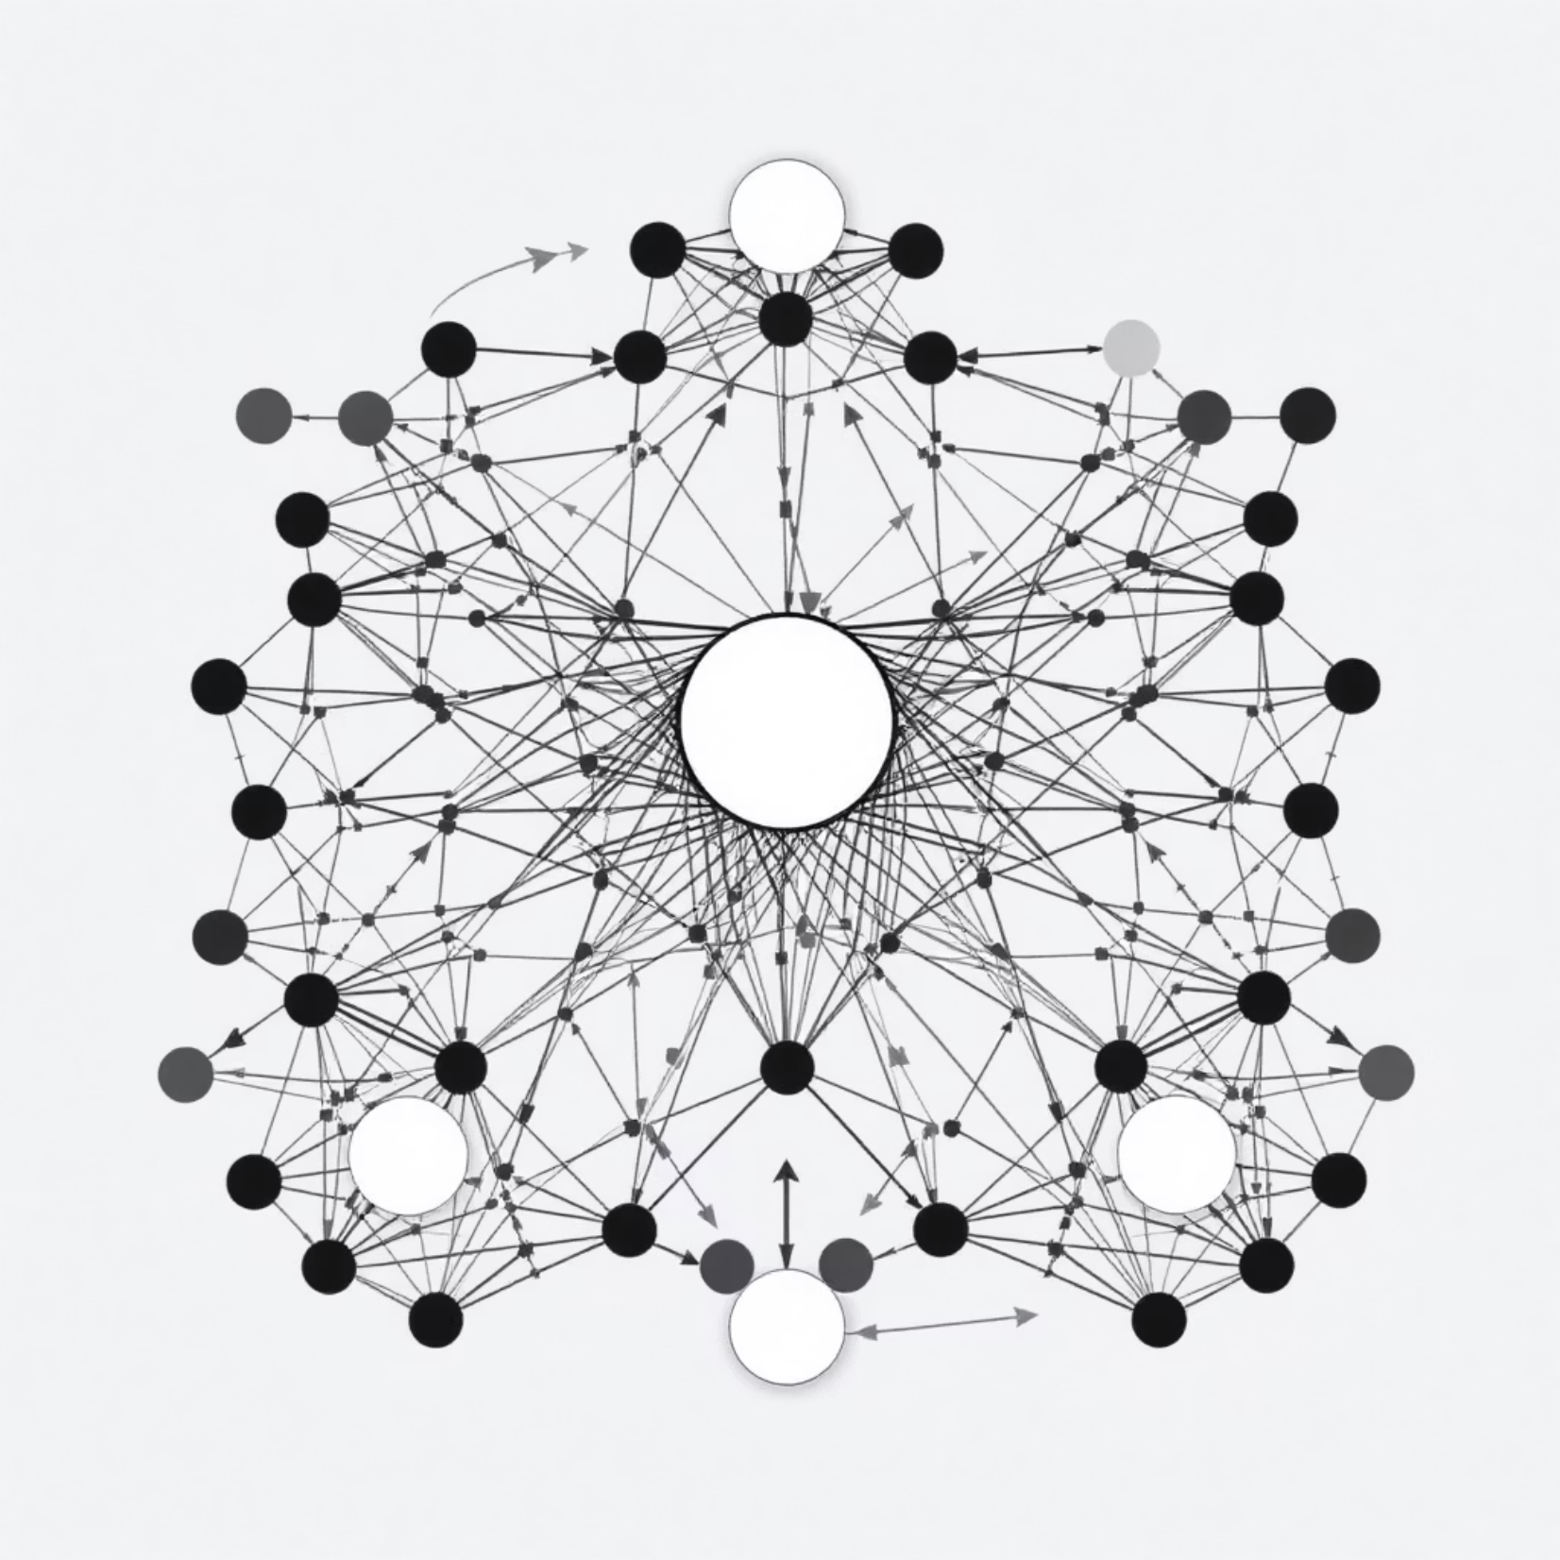
DQN Agent Architecture
The DQN utilizes a CNN-based architecture, drawing inspiration from the original DeepMind DQN paper. This network efficiently processes the 4 stacked frames, generating Q-values for each possible action.
Key components like an experience replay buffer and a target network were implemented to stabilize training and improve learning efficiency, preventing oscillations and divergence often seen in deep reinforcement learning.

Slide 5
Training Strategy
1
2
Epsilon-Greedy Policy
Bellman Equation Update
Starts at 1.0, gradually decays to 0.01 to balance exploration and exploitation.
Q-values updated based on discounted future rewards with gamma = 0.99.
3
4
Learning Rate
Initial Training
Alpha = 0.00025 for effective gradient descent.
100 episodes for performance evaluation and debugging.

Slide 6
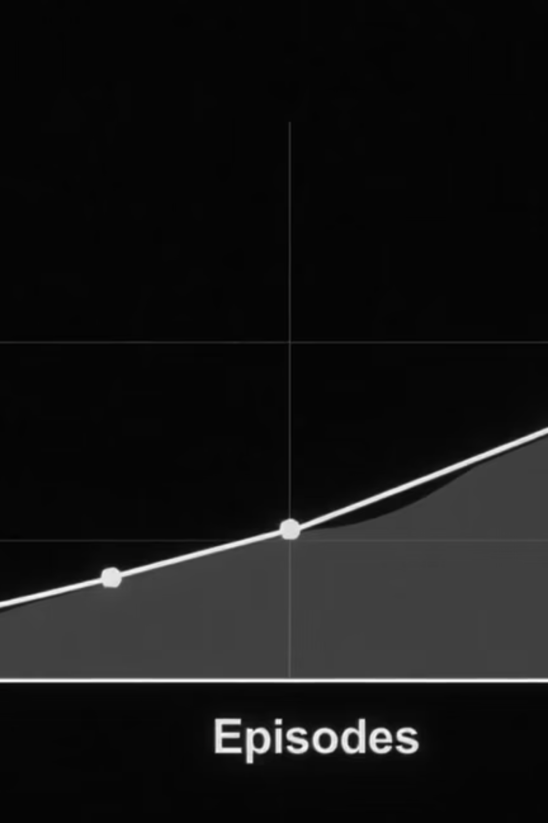
Baseline Results
After the initial training, the agent demonstrated modest improvement, surpassing random actions. Total rewards per episode were tracked and plotted, providing a clear visualization of the learning progression. This establishes a crucial baseline for comparative analysis against future policy refinements or hyperparameter adjustments, enabling iterative optimization.

Slide 7

Video Rendering
A gameplay video was meticulously recorded by saving individual frames from a test run conducted post-training. These frames were then expertly converted into an MP4 video using imageio and ffmpeg. This visual artifact vividly demonstrates the agent's real-time decision-making and movement within the Tennis-v5 environment, showcasing its learned Q-values in action.

Slide 8



Reflections & Integration with LLMs
DQN vs. LLM Agents
Shared Benefits
Hybrid Agents
DQN is model-free, learning from rewards; LLM agents use prior knowledge and structured reasoning.
Both benefit from exploration, memory (context/history), and training.
Future direction: combining Q-Learning with LLM planning or instruction-following.

Slide 9




Attribution & License
This project leveraged adapted components from PyTorch tutorials, Gymnasium's official documentation, AutoROM for ROM installation, and OpenAI's Gym APIs. All dependencies are properly cited and conform to open-source licenses, ensuring transparency and adherence to community standards.

Slide 10

Conclusion & Future Skills
This project provided invaluable hands-on experience in reinforcement learning, agent design, and environment interaction. It honed essential AI engineering skills by challenging me to debug environment wrappers, input shapes, and training logic. These experiences are crucial for navigating the complexities of modern AI development.

